Slide 1
String Handling
School of Computer Engineering

Slide 2
Outline
Fundamentals of Characters and Strings
Class String: String Constructors
String Methods: String extractions, string comparison, Searching strings, modifying a string, ToString() and valueOf() methods
Class StringBuffer
  StringBuffer Constructors
  StringBuffer Methods: length, capacity, setLength, ensureCapacity
  StringBuffer Methods: charAt, setCharAt, getChars, and reverse
  StringBuffer Methods: append, insertion, deletion
Class StringTokenizer

Slide 3
Fundamentals of Characters and Strings
Characters
  “Building blocks” of non-numeric data
  ‘A’, ‘a’, ‘5’, ‘@’
String
  Sequence of characters treated as single unit or literal
  May include letters, digits, etc.
  In java String is a non-primitive datatype or reference datatype
  Strings are objects of predefined class String
  Unlike C/C++, Strings in Java do not have a null character at the end

Slide 4
Introduction
In Java, Strings are a sequence of Unicode characters
String is a predefined class present in java.lang package
It is a final class, that means String class cannot be inherited
String is a child class of an Object class
It implements the CharSequence, Comparable, and Serializable interfaces
String constants or iterals are stored in the heap area named as
“String Constant Pool” (SCP) or “String Literal Pool” (SLP)
String objects are immutable

Slide 5
Declaration of String class
public final class String extends Object implemts CharSequence, Serializable, Comparable { … }
String class provides nine constructors
Null constructor String( ) has no characters and a length of zero
String(array, start index, number of characters)
String may be constant sequence of character or literal, array of characters, and array of bytes
  String s = “Hello”; //Literal “Hello” is stored in String Constant Pool and
referred by reference variable s
  String s1 = new String(“Hello”); // Literal “Hello” is stored in heap memory
and reference variable s1 is stored in stack memory

Slide 6
class MyStringDemo { public static void main(String args[]) { char charArray[] = {'K','I','I','T'}; byte byteArray[] = {(byte)'K’, (byte)'I', (byte)'I', (byte)'T'}; String s = new String(); //String default constructor //instantiates empty string String s1 = new String(charArray); String s2 = new String(charArray,1,3); String s3 = new String(byteArray); String s4 = new String(byteArray,1,3); | String s5 = s1.concat(" JAVA"); //Concatenate a string to a string constant //and stored in another string variable String s6 = s1+" JAVA"; //Concatenate a string to a string constant //and stored in another string variable System.out.println(s); System.out.println(s1); System.out.println(s2); System.out.println(s3); System.out.println(s4); System.out.println(s5); System.out.println(s6); } }

Slide 7
Creating a String in Java
There are two ways to create a String in Java
  String literal
  Using new keyword
String literal
In java, Strings can be created using String literal: Assigning a String literal to a String instance:
String str1 = "Welcome";
String str2 = "Welcome";
String constant pool is special memory location present in Heap area which is used to store String literal.

Slide 8
String Constant Pool or String Literal Pool
The String constant pool is a special memory area in the heap memory. When we declare a String literal, the JVM creates the string object in the pool and stores its reference on the stack. Before creating each String object in memory, the JVM performs some steps to decrease the memory overhead.
But if the string object already exist in the SCP JVM does not create a new object rather it assigns the same old object to the new instance, that means even though we have two string instances above(str1 and str2) compiler only created on string object (having the value “Welcome”) and assigned the same to both the instances. For example there are 10 string instances that have same value, it means that in memory there is only one object having the value and all the 10 string instances would be pointing to the same object.
The variables created on the stack are deallocated as soon as the method completes execution. In contrast, a garbage collector reclaims the resources in the heap. Similarly, the garbage collector collects the un- referenced items from the pool.

Slide 9
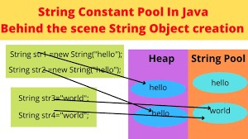
How strings are stored in memory

Slide 10
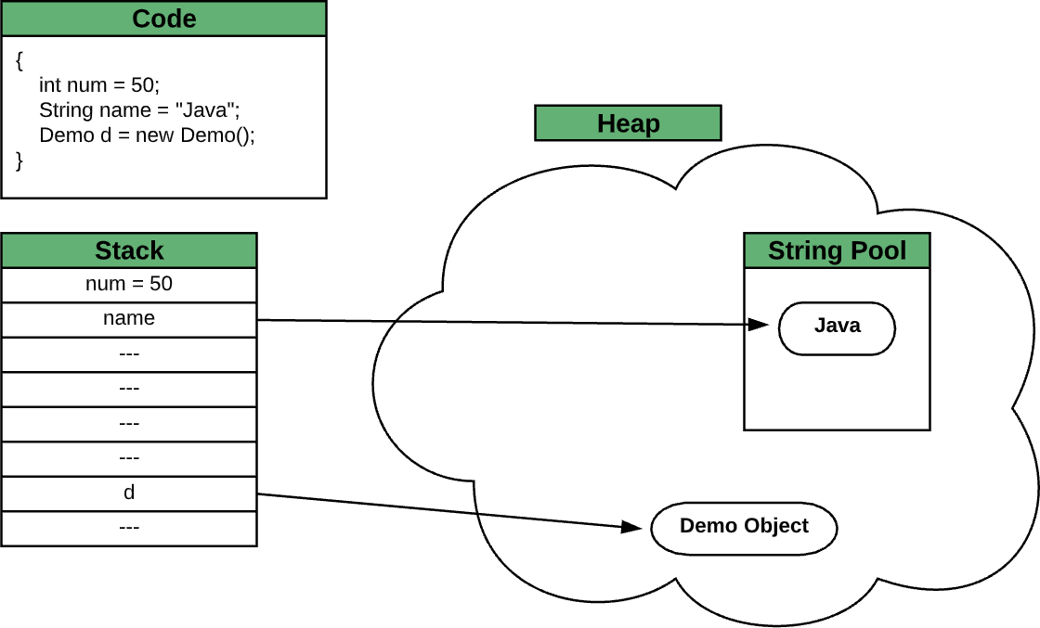
Storing variables and objects in Java program

Slide 11
Some widely used String Methods
length(): Returns the length of the string.
  String str = "Hello, World!";
  int len = str.length(); // len will be 13
charAt(): Returns the character at the specified index in the string.
  String str = "Hello, World!";
  char ch = str.charAt(0); // ch will be 'H'
substring(): Returns a new string that is a substring of the original string.
  String str = "Hello, World!";
  String subStr1 = str.subString(0, 5); // subStr1 will be "Hello"
  String subStr2 = str.subString(7); // subStr2 will be "World!"

Slide 12
Contd…
toUpperCase() and toLowerCase(): Returns a new string with all characters in upper or lower case.
  String str = "Hello, World!";
  String upperStr = str.toUpperCase(); // upperStr will be "HELLO, WORLD!"
  String lowerStr = str.toLowerCase(); // lowerStr will be "hello, world!“
The getChars() method in Java is used to extract a sequence of characters from a String and store them in a character array.
  void getChars(int srcBegin, int srcEnd, char[] destination, int destBegin)
The getBytes() method in Java is used to convert a String to an array of bytes using the platform's default character encoding.
String str = "Hello, World!";
// Get the byte representation of the string byte[] bytes = str.getBytes();
// Print the byte representation of the string
for (byte b : bytes) { System.out.print(b + " ");
}

Slide 13
Contd…
equals() and equalsIgnoreCase(): Compares the current string with another string and returns true if they are equal.
startsWith() and endsWith(): Returns true if the current string starts or ends with the specified character or sequence.
  String str = "Hello, World!";
  boolean result1 = str.startsWith("Hello"); // result1 will be true
  boolean result2 = str.endsWith("World!"); // result2 will be true
The indexOf() method in Java is used to find the index of the first occurrence of a specified substring within a String.
  public int indexOf(char ch, int fromIndex)
The concat() method in Java is used to concatenate one String to the end of another String.

Slide 14
Contd…
The toCharArray() method in Java is used to convert a String to a character array.
String str = "Hello, World!"; char[] chars = str.toCharArray();
// Print the contents of the character array
for (char c : chars) {
System.out.print(c + " ");
}
The trim() method in Java is used to remove leading and trailing white space characters from a String.
String str = " Hello, World! "; String trimmed = str.trim();
// Print the trimmed string System.out.println(trimmed); // Output: "Hello, World!"

Slide 15
Contd…
It's
worth noting that the trim() method only removes white space
characters from the beginning and end of the String. It does not remove
white space characters that appear within the String. If you need to remove white space characters from within a String, you can use other methods such as replaceAll() or replace().
contains(): Returns true if the current string contains the specified
character or sequence.
String str = "Hello, World!"; boolean s1 = str.contains("Hello"); boolean s2 = str.contains("Java");
// Print the results System.out.println(s1); // Output: true System.out.println(s2); // Output: false
It's worth noting that the contains() method is case-sensitive, so it will only match sequences of characters that have the same case as the parameter. If you need to perform a case-insensitive search, you can convert both the String and the parameter to lowercase or uppercase using the toLowerCase() or toUpperCase() method before calling contains().

Slide 16
Java program that counts the number of vowels present in a given String
import java.util.Scanner;
public class CountVowels {
public static void main(String[] args) {
Scanner input = new Scanner(System.in); System.out.print("Enter a string: "); String str = input.nextLine();
int count = 0;
for (int i = 0; i < str.length(); i++) { char ch = str.charAt(i);
if (ch == 'a' || ch == 'e' || ch == 'i' || ch == 'o' || ch == 'u' || ch == 'A' || ch == 'E' || ch == 'I' || ch == 'O' || ch == 'U') { count++;
str.setCharAt(i, Character.toUpperCase(ch));
}
}
System.out.println("Number of vowels: " + count);
System.out.println(“Modified String: " + str.toString());
}
}

Slide 17
Contd…
join(CharSequence delimiter, CharSequence... elements): Concatenates a sequence of strings with the specified delimiter.
String[] words = {"The", "quick", "brown", "fox", "jumps", "over", "the", "lazy", "dog"};
String str = String.join(" ", words);
System.out.println(“Modified String: " + str.toString());
valueOf() methods: The String class provides valueOf() methods to convert primitive data types into Strings.
int i = 42;
double d = 3.14159;
String str1 = String.valueOf(i); // "42" String str2 = String.valueOf(d); // "3.14159"

Slide 18
StringBuffer Class
The StringBuffer class provides for strings that will be modified; you use string buffers when you know that the value of the character data will change.
A StringBuffer object is like a String, but it can be changed or modified.
StringBuffer class is present in java.lang package.
It is a final class and thus it cannot be inherited.
A StringBuffer class in Java is a subclass of Java.lang.Object class and implements the interfaces, CharSequence and Serializable.
An instance of StringBuffer class represents a string that can be dynamically modified.
The objects of String class are immutable, whereas the objects of a String Buffer class are mutable.

Slide 19
Use the following guidelines for deciding which class to use:
If your text is not going to change, use a String class.
If your text will change, and will only be accessed from a single thread, use a StringBuilder class.
If your text will change, but will be accessed from multiple threads, use a StringBuffer class because StringBuffer class is thread-safe.

Slide 20
Constructor of StringBuffer
StringBuffer ( ) | This constructs an empty StringBuffer
StringBuffer (int capacity) | This constructs an empty StringBuffer with the specified intial capacity
StringBuffer (String s) | This constructs a StringBuffer that initially contains the special string
The StringBuilder class, introduced in JDK 5.0, is a faster, drop-in replacement for string buffers. You use a string builder in the same way as a string buffer, but only if it's going to be accessed by a single thread.

Slide 21
Comparison of String, StringBuffer and StringBuilder
String | StringBuffer | StringBuilder
Storage: Heap area SCP | Heap area | Heap area
Object: Immutable | Mutable | Mutable
Memory: If we change the value of String a lot of times, it will allocates more space. | Consumes less memory | Consumes less memory
Thread safe: Not thread safe | All methods are synchronized and thread safe | All methods are non- synchronized and not thread safe.
Performance: Slow | Fast as compared to String | Faster that StringBuffer

Slide 22
Methods of StringBuffer
public synchronized int length() : This method returns the length of the StringBuffer
public synchronized int capacity() : This method returns the capacity of the amount of space allocated rather than the amount of space used.
public synchronized void setLength(int length) : This method is used to set the length of the StringBuffer.
public synchronized void ensureCapacity(int capacity) : This method is used to set the capacity of the StringBuffer.
public synchronized char charAt(int index) : This method returns a character from the StringBuffer.
public synchronized void getChars(int start, int end, char c[], int index) : This method extracts more than one character from StringBuffer.

Slide 23
Contd…
public synchronized void setCharAt(int index, char ch) : This method sets a character in the StringBuffer.
public synchronized StringBuffer append(Object o) : This method calls toString() on Object o and appends the result to the current StringBuffer.
public synchronized StringBuffer append(String s) : This method appends a string in the StringBuffer.
public synchronized StringBuffer append(StringBuffer sb) : This method appends a StringBuffer object to the existing StringBuffer.
public synchronized StringBuffer append(char c) : This method appends a character to the existing StringBuffer.
public synchronized StringBuffer delete(int index, int length) : This method is used to delete more than one character from the StringBuffer.

Slide 24
Contd…
public synchronized StringBuffer deleteCharAt(int index) : This method is used to delete a character from the StringBuffer.
public synchronized StringBuffer replace(int index, int length, String s) : This method is used to replace a string in the StringBuffer.
public synchronized StringBuffer insert(int index, String s) : This method is used to replace a string in the StringBuffer.
public synchronized StringBuffer reverse() : This method is used to reverse the StringBuffer.
public String toString() : This method is used to convert a string to a StringBuffer.

